Slide 1
In the name of God

Slide 2
Management of asthma during pregnancy
Parisa Rezaeifar M.D.
Pulmonologist

Slide 3
Introduction
impacts 3 to 8 percent of all pregnancies.
Pregnancy may be associated with changes in the course of asthma, and asthma may affect the outcome of pregnancy.
In general, asthma worsens during pregnancy in approximately 30 to 40 percent of patients and either remains stable or improves in the remainder.
Asthma severity prior to pregnancy is related to asthma severity during pregnancy
Asthma exacerbations affect 20 to 45 percent of pregnant asthmatic patients and tend to occur during the middle trimester
Asthma is associated with a significant increase in pregnancy complications, such as perinatal mortality, preeclampsia, and preterm delivery.

Slide 4
There is a small but significant increase in complications of pregnancy in patients with asthma at baseline.
patients with asthma, on average, have a 15 to 20 percent increased risk of perinatal mortality, preeclampsia, preterm delivery, or low birth weight infants
patients with more severe asthma have a 30 to 100 percent increased risk

Slide 5
MAINTAINING ASTHMA CONTROL
Asthma may improve, worsen, or remain unchanged in severity during pregnancy
The two primary goals of asthma management
prevention of acute exacerbations
optimization of ongoing asthma control
the benefit of active treatment to maintain asthma control and prevent exacerbations outweighs the potential risks of routinely used asthma medications

Slide 6
Adjustments to pharmacologic therapy in pregnancy
The general principles of pharmacologic therapy for asthma during pregnancy are similar to those in nonpregnant patients and involve a step-wise approach to achieve and maintain asthma control, as recommended by national and international guidelines

Slide 7
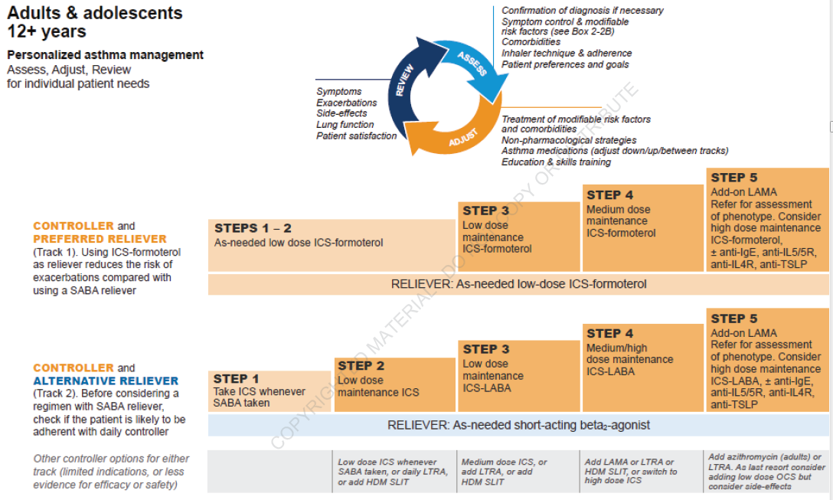

Slide 8
Current guidelines emphasize the following points:
All patients should have access to an inhaler for quick relief of asthma symptoms.
Choices include a short-acting beta-agonist (eg, albuterol) or a combination inhaler with formoterol and a low-dose inhaled glucocorticoid (eg, formoterol-budesonide).

Slide 9
For patients with mild persistent or more severe asthma, inhaled glucocorticoids reduce exacerbations during pregnancy, and cessation of inhaled glucocorticoids during pregnancy increases the risk of an exacerbation.
Budesonide has been the preferred inhaled glucocorticoid
Other inhaled glucocorticoids could be continued if the patient was well-controlled on one of these medications prior to pregnancy
More recent data for fluticasone have been reassuring regarding the risk for low birth weight (<2500 grams), small for gestational age (<10 percentile for babies of same gestational age), preterm birth (<37 weeks), and major congenital malformations

Slide 10
Salmeterol has been recommended as the inhaled long-acting beta agonist of choice in the United States due to the longer duration of clinical experience with this agent compared with formoterol.
Retrospective cohort studies provide reassuring data for both salmeterol and formoterol .
Neither of these agents should be used in asthma without an inhaled glucocorticoid.

Slide 11
A leukotriene modifier (montelukast or zafirlukast) could be considered as an alternative for mild persistent asthma or as add-on therapy to inhaled glucocorticoids, especially for patients who have shown a uniquely favorable response to this class of agents prior to pregnancy.

Slide 12
Inhaled beta-adrenergic agonists
The majority of reports provide reassurance regarding the use of inhaled beta-agonists during pregnancy.
Clinical experience is greater with the older agents (eg, albuterol) than with the newer ones (eg, formoterol, salmeterol).
SABA: some case-control studies have suggested a slight increase in risk of certain infant abnormalities
the absolute increase in risk is very small and less than the risk of poorly-controlled maternal asthma.

Slide 13
LABA:
Salmeterol is not expected to increase the risk of congenital anomalies, based on data from animal studies and limited human experience.
Animal studies are also reassuring for formoterol, although data from human pregnancies are limited
Salmeterol and formoterol do not increase the risk of delivering low birth weight, small for gestational age, or preterm infants
When comparing a combination LABA plus inhaled glucocorticoid versus monotherapy with a higher dose of the inhaled glucocorticoid, the risk of congenital malformations appears similar

Slide 14
Oral/Systemic glucocorticoids
Systemic glucocorticoids have been used fairly extensively during pregnancy to treat asthma exacerbations and rarely for control of severe asthma.
As the risks of severe uncontrolled asthma include maternal or fetal mortality, these risks are considered to be greater than the potential risk of systemic glucocorticoids.
oral glucocorticoids should be used during pregnancy when indicated for the management of severe asthma

Slide 15
Congenital malformations: Palatal closure is usually complete by the 12th week of pregnancy, so potential risk would be limited to administration during the first trimester.

Slide 16
Inhaled glucocorticoids
In contrast with oral/systemic glucocorticoids, the safety data on inhaled glucocorticoids are reassuring.
Budesonide, beclomethasone, and fluticasone are preferred among the inhaled glucocorticoids as more safety information is available for these agents.
If the patient’s asthma was already well-controlled on an alternate agent (eg, ciclesonide, mometasone) prior to pregnancy, there is no need to change therapy.

Slide 17
Muscarinic antagonists
SAMA: Gestational animal studies are reassuring for ipratropium
Inhaled ipratropium, which is sometimes used for quick relief of asthma symptoms during an exacerbation, is felt to be safe for intermittent use during pregnancy
LAMA: The safety of inhaled tiotropium during pregnancy is uncertain as adverse effects were reported with high doses in animal studies and human fetal outcomes have not been reported
Other LAMAs (eg, aclidinium, glycopyrrolate, and umeclidinium) are not approved for use in asthma, although it is reasonable to assume that they would have similar effects.

Slide 18
Biologics
Anti-immunoglobulin E — Omalizumab
The initiation of omalizumab during pregnancy is not recommended
If a woman becomes pregnant while receiving omalizumab, it is suggested that therapy can be continued if the benefits are estimated to outweigh the potential harms.

Slide 19
Rarely used medications
Methylxanthines – The clinical use of methylxanthines (theophylline, aminophylline) during pregnancy is limited because of the potential for altered metabolism during pregnancy, the need for drug level monitoring, and the potential for fetal tachycardia and irritability at the time of delivery.
Moreover, inhaled glucocorticoids have been shown to be more effective than theophylline for persistent asthma in non-pregnant patients and at least as effective as theophylline with fewer side effects during pregnancy
Theophylline does not increase the risk of fetal anomalies

Slide 20
Cromoglycates:
cromolyn sodium and nedocromil → Not recommended

Slide 21
Nonpharmacologic treatments
Patient education
Smoking cessation
Control of environmental triggers

Slide 22
ACUTE EXACERBATIONS
Acute asthma exacerbations are common during pregnancy and increase the risk of preeclampsia, gestational diabetes, placental abruption and placenta previa.
The recommended pharmacotherapy of acute asthma during pregnancy does not differ substantially from the management in non-pregnant patients.
Intensive monitoring of both mother and fetus is essential.
Continuous measurement of oxygen saturation by pulseoximetry (SpO2) is prudent, aiming for a SpO ≥95 percent.

Slide 23
Maternal monitoring
Measurement of expiratory airflow with a peak flow meter (or spirometer) is the best method for objective assessment of the severity of an asthma attack.
Normal values for peak expiratory flow are not significantly altered by pregnancy.
The changes in blood gases that occur secondary to acute asthma during pregnancy are superimposed on the "normal" respiratory alkalosis of pregnancy.
An arterial carbon dioxide tension (PaCO2 ) >35 mmHg or an arterial oxygen tension (PaO2 ) <70 mmHg associated with acute asthma can represent more severe compromise during pregnancy than in the nongravid state.

Slide 24
A chest radiograph is not indicated for the majority of asthma exacerbations
CXR reserved for patients with suspected pneumonia, pneumothorax, or impending or actual respiratory failure.

Slide 25
Fetal monitoring
Fetal heart rate monitoring is the best available method for determining whether the fetus is adequately oxygenated.

Slide 26
Supportive care
Maternal positioning – In general, pregnant patients with acute asthma should rest in a seated or lateral position, rather than supine, particularly in the third trimester, to avoid aortocaval compression by the gravid uterus.
Hydration – Intravenous fluids are not necessary unless the patient is unable to maintain oral hydration.

Slide 27
Supplemental oxygen
Supplemental oxygen (initially 3 to 4 L/min by nasal cannula) should be administered, adjusting the fraction of inspired oxygen (FiO2 ) to maintain a PaO2 of at least 70 mmHg and/or oxygen saturation by pulse oximetry of 95 percent or greater.

Slide 28
Medications
The recommended agents for management of acute asthma exacerbations in pregnant patients are the same as for asthma exacerbations in nonpregnant adults and adolescents.
These agents include inhaled short-acting beta agonists, inhaled ipratropium, oral or intravenous glucocorticoids, and, if appropriate, intravenous magnesium sulfate

Slide 29
Due to theoretic concerns that the alpha–adrenergic effects of epinephrine might cause vasoconstriction in the uteroplacental circulation, recommended that:
epinephrine generally be avoided during pregnancy except in the setting of anaphylaxis.
For the rare patient who requires use of a systemic beta-agonist to treat asthma, subcutaneous administration of terbutaline is a reasonable choice

Slide 30
Intravenous aminophylline/theophylline is NOT generally recommended for use in the emergency management of acute gestational asthma
aminophylline/theophylline provides no additional benefit to optimal inhaled beta agonist and intravenous glucocorticoid therapy
In addition, when used in combination with intensive inhaled beta-agonist therapy, intravenous aminophylline causes increased adverse side effects

Slide 31
Respiratory infections
Most respiratory infections that trigger an exacerbation of asthma are viral rather than bacterial and do not require antibiotic therapy.
However, testing for and treatment of influenza and COVID-19 may be appropriate, depending on the time of year and symptom pattern.

Slide 32
PERIPARTUM CARE
Oxytocin is the drug of choice for induction of labor and control of postpartum hemorrhage.
Analogs of prostaglandin F2-alpha (eg, carboprost) can cause bronchoconstriction and should not be used for termination of pregnancy, cervical ripening, induction of labor, or control of uterine hemorrhage
Prostaglandin E2 (dinoprostone, in gel or suppository form) and prostaglandin E1 (misoprostol) are considered safer analogs, if prostaglandin treatment is required, due to their bronchodilatory effects
For peripartum pain control, morphine and meperidine should be avoided, if possible, since they can induce histamine release, especially from skin mast cells; however, evidence of acute bronchoconstriction caused by these agents is lacking
Butorphanol or fentanyl may be appropriate alternatives

Slide 33
Epidural anesthesia is preferred for the asthmatic patient who opts for pain control during labor because it reduces oxygen consumption and minute ventilation in the first and second stages of labor and usually can provide adequate anesthesia if cesarean delivery becomes necessary.
If general anesthesia is required, ketamine and halogenated anesthetics are preferred, because they may have a bronchodilatory effect.
If high doses of SABA have been given during labor and delivery, blood glucose levels should be monitored in the baby (especially if preterm) for the first 24 hours.

